Slide 1
Employee Data Analysis using Excel
STUDENT NAME: THAMARAI SELVI.S
REGISTER NO: 312218164
NAAN MUDHALVAN ID:82F0A6D2B5EBF89AF1F4D3C6E4B60E3F
DEPARTMENT: B.COM GENERAL
COLLEGE: ST.ANNE’S ARTS AND SCIENCE COLLEGE

Slide 2
PROJECT TITLE
Employee Performance Analysis using Excel

Slide 3


AGENDA
Problem Statement
Project Overview
End Users
Our Solution and Proposition
Dataset Description
Modelling Approach
Results and Discussion
Conclusion
3/21/2024 Annual Review

Slide 4

PROBLEM STATEMENT
This project aims to analyze employee performance based on satisfaction levels using Excel. The goal is to identify patterns and correlations within the data to help improve employee satisfaction and performance across different demographics and business units.

Slide 5

PROJECT OVERVIEW
The "Employee Performance Analysis Using Excel" project focuses on evaluating employee performance by analyzing key factors such as satisfaction levels, gender, and business unit. The project involves collecting and organizing employee data in Excel, followed by detailed analysis using statistical functions and data visualization tools. By identifying trends and correlations, the analysis will provide insights into how different factors impact performance across various demographics and departments. The findings will support data-driven decision-making to enhance employee satisfaction and optimize performance within the organization.
.

Slide 6





WHO ARE THE END USERS?
3.EXECUTIVES
HR MANAGER
2. DEPARTMENT MANAGER
4. DATA ANALYST

Slide 7

OUR SOLUTION AND ITS VALUE PROPOSITION
CONDITIONAL FORMATTING:
FILTER:
FORMULA:
PIVOT TABLE:
SLICER :
GRAPH:

Slide 8
Dataset Description
Dataset Name: Employee Performance Analysis Data
Description: Contains performance metrics for employees, including satisfaction scores, performance ratings, and demographic details.
Source: Kaggle.com
Variables/Columns:
Name: First name
Gender: Male and Female
Business Unit: BPC, CCDR, EW, MSC, NEL, PL, PYZ, SVG, TNS, WBL
Performance Grade: A+, A, B, C
Satisfaction Score: 1-5
Data Types: Numeric and Text
Units of Measurement:
Satisfaction score: Scale of 1-5
Performance Grade: A+, A, B, C
Size: 26 records, 9 fields
Visualization: Bar graph

Slide 9

THE "WOW" IN OUR SOLUTION
FORMULA:
Performance Grade: =IF(Z8>=5,"A+",IF(Z8>=4,"A",IF(Z8>=3,"B+",IF(Z8>=2,"C","NO GRADE"))))
INSIGHTS:
Used to evaluate the scores as grade from A+ to C
3/21/2024 Annual Review
9

Slide 10
MODELLING
DATA COLLECTION:
Gather all relevant data related to employees. Common fields include employee ID, name, business unit, employee status, employee type, employees classification type, current employee rating, and more.
DATA CLEANING:
Handle Missing Values:
Identify missing values in each column using conditional formatting.
PERFORMANCE GRADE:
Creating the new column called performance Grade by using the formula=IF(Z8>=5,"A+",IF(Z8>=4,"A",IF(Z8>=3,"B+",IF(Z8>=2,"C","NO GRADE"))))
It shoes that how his formula is used to categorised the employees based on their grades like A+, A,B,C
SUMMARY:
Pivot Table:
In the pivot table it should work in the new worksheet.
10

Slide 11
Remove the blank values.
VISUALISATION:
Graphical Representation:
Make a graph based on the table which we have created.
There is the feature of recommended graph
Filter:
We can also filter the graph like male, female etc.
We also filter the analysis by our choose

Slide 12
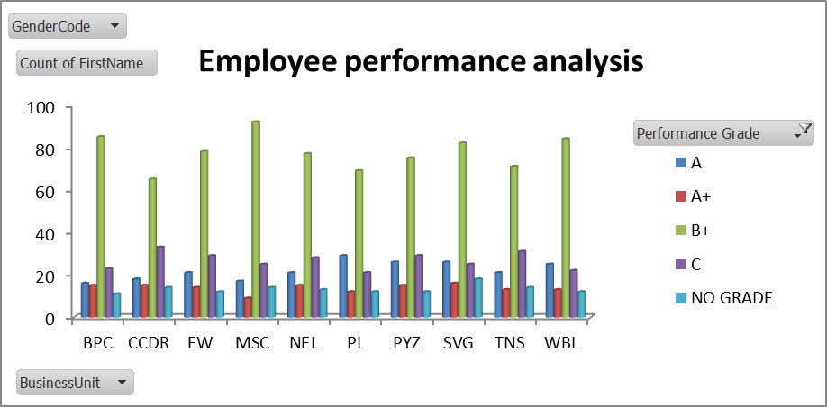
RESULTS
12

Slide 13
RESULTS

Slide 14
conclusion
The employees should summarize the performance during the re-view period, highlight their strengths, and identify areas for improvement.
The conclusion can also include plans for the employee’s future development.
Employee performance management is an essential part of any successful organization. It provides the necessary feedback to develop employees, encourage growth, and align goals goals with company objectives.
It is used as the basis for a salary increase, promotion or termination of an employee

